Slide 1

Setting up Git using GitHub
Microsoft Student Accelerator
Microsoft NZ

Slide 2
Version Control
Helps manage codebases by recording changes to code over time
Collaborate with team or members of the community
Git
Team Foundation Server (TFS)

Slide 3





What is Git?
Git is an open source program for tracking changes in text files. It was written by the author of the Linux operating system, and is the core technology that GitHub, Bitbucket, beanstalk and many more are based on

Slide 4
Creating an account
You can create a free GitHub account here https://github.com/
The free account gives you unlimited public repos and collaborators
As a student, you can get FREE private repos (up to 5) https://education.github.com/pack

Slide 5
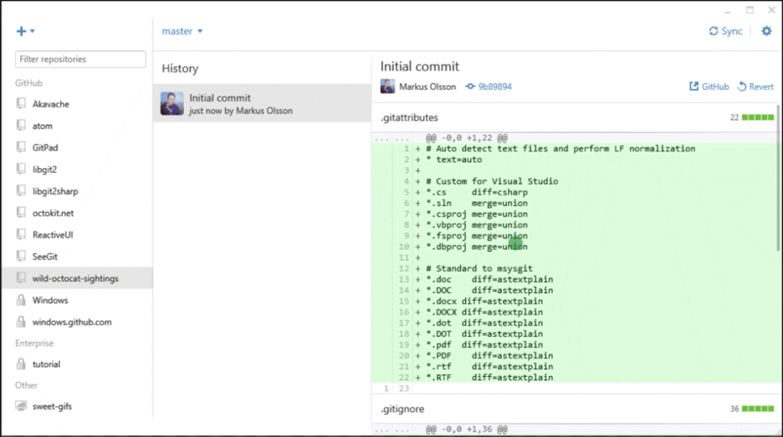
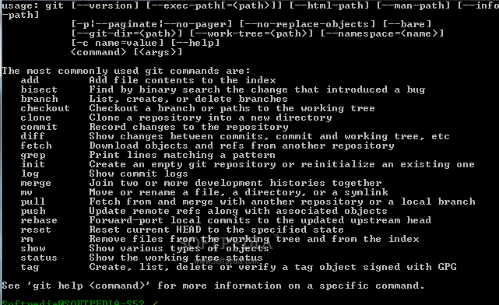
GitHub GUI vs CLI
You can do most things with the GUI
CLI will come in handy if you want to automate operations or get your repo in a weird state :/

Slide 6
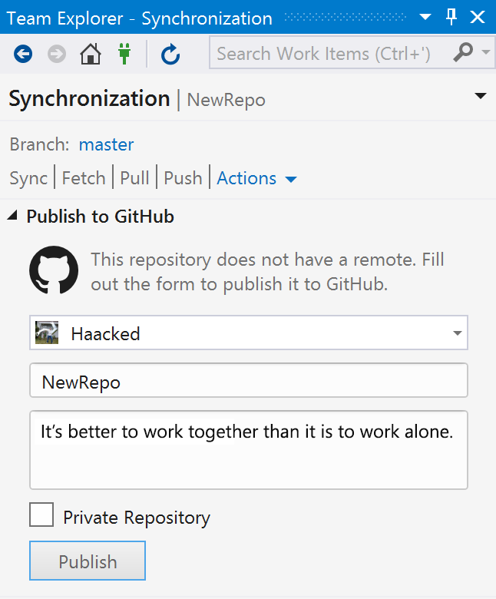
GitHub Extension for Visual Studio
Connect to repositories in Visual Studio
Download the extension here: https://visualstudio.github.com
(note: requires VS 2015)

Slide 7
Basic Concepts
A repository:
Maintains commits (snapshots) of the codebase (through diffs and file versions)
Allows you to revert to any previous commit or branch (set of commits)
Can by synchronized with other repositories
Git allows you to work remotely, then push and pull from a central repository

Slide 8
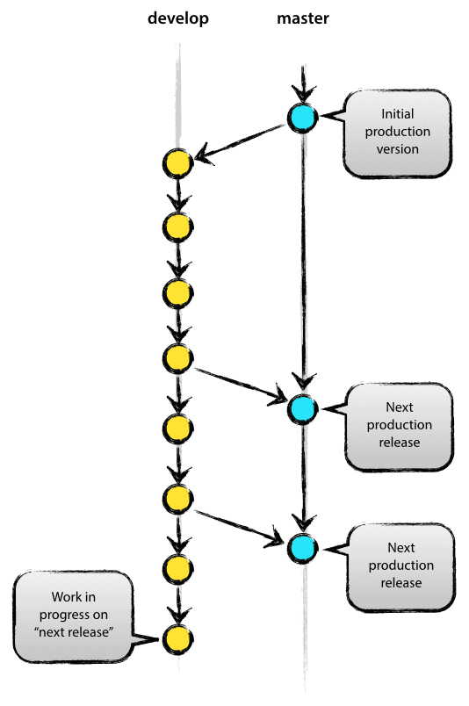
Main Branches
Two branches develop, master
When code in develop become stable, all changes are merged back to master
A merge back into master is considered a new production release
Source: http://nvie.com/posts/a-successful-git-branching-model/
Notes:
Branch is when you make an exact copy of the codebase to work on. From a high level, you normally have two branches. In your Github repository, its good practice to need to keep your master branch clean - so If you want to fix a bug or add a feature, you create a branch for it.. So if you branched from master, and call that branch develop (lik the diagram) develop would be a copy of the master at that point

Slide 9
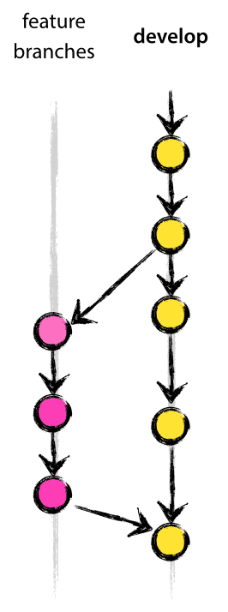
Supporting Branches
New branch for each feature
Makes it easier to revert a whole feature
Ensure completeness before merging
Finished features may be merged back into develop branch for upcoming release
Source: http://nvie.com/posts/a-successful-git-branching-model/

Slide 10

DEMO
Create a new repository
Add files to repo
Commit / Sync / Undo
Conflicts
Branch + Pull Request

Slide 11
GitHub Help
Visual Studio Extension Help
https://visualstudio.github.com/help.html
Command Line Interface (CLI)
https://try.github.io/
https://training.github.com/kit/courses/github-for-developers.html
GitHub Desktop App (GUI)
https://training.github.com/kit/courses/github-for-everyone.html
https://guides.github.com/

Slide 12


